Slide 1
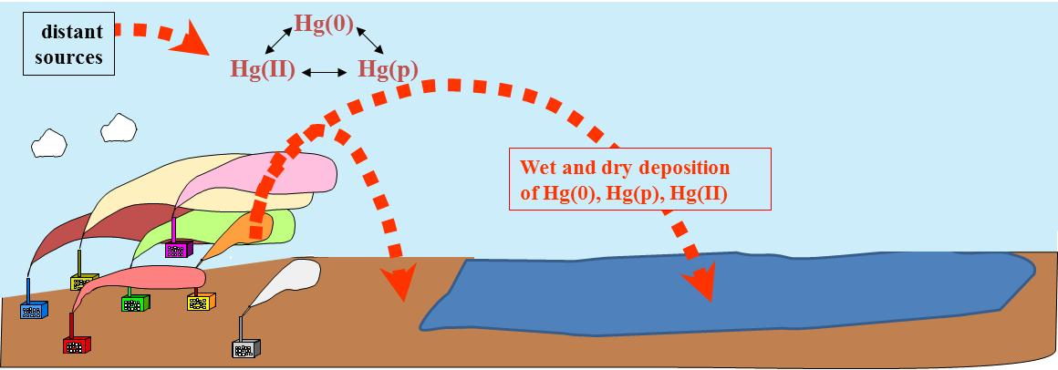
Atmospheric Mercury Modeling
Mark Cohen
NOAA Air Resources Laboratory

Slide 2

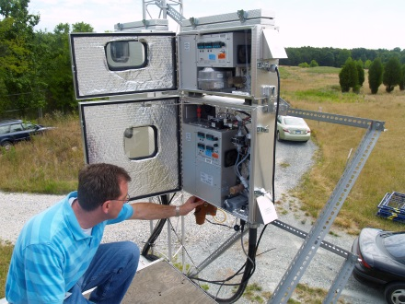

Acknowledgements
Others in ARL Headquarters HYSPLIT team:
  Ariel Stein
  Glenn Rolph
  Barbara Stunder
  Fantine Ngan
Others in ARL’s mercury group:
  Winston Luke
  Paul Kelley
  Xinrong Ren
ARL IT:
  Rick Jiang
  Fred Shen
  Tianfeng Chai
  Alice Crawford
  Chris Loughner
  Roland Draxler (retired)

Slide 3


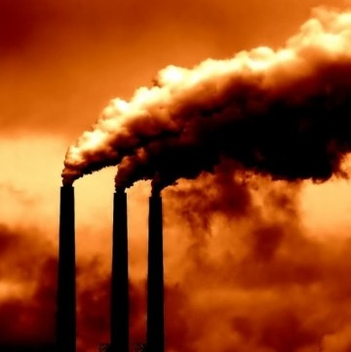


Context
Mercury exposure via fish consumption is an important public health concern due to fetal and infant neurotoxic effects
Fish consumption advisories due to mercury are still ubiquitous throughout the U.S.
Atmospheric emissions & subsequent deposition is a major pathway for mercury contamination of aquatic ecosystems
Regulatory efforts hampered by controversies (e.g., global vs. domestic contributions?)
June 30, 2015
The Supreme Court halts Obama administration’s mercury regulations
Notes:
Picture of pregnant women from:
https://www.epa.gov/fish-tech/epa-fda-advisory-mercury-fish-and-shellfish
Smoke stack picture from:
http://cache.golocalworcester.com.s3.amazonaws.com/cache/images/cached/cache/images/remote/http_s3.amazonaws.com/images.golocalworcester.com/news/smoke_stack1_360_361_90.jpg
Article headline from this article:
https://www.washingtonpost.com/news/powerpost/wp/2015/06/30/the-supreme-court-halts-obama-administrations-mercury-regulations/
http://www.sciencemag.org/news/2015/06/us-high-court-topples-controversial-mercury-pollution-regulations
--------------------------------------------------------------------------------------------------------------------------
Gavel Comes Down on EPA Regulations, C&E News, May 5, 2008 Volume 86, Number 18, p. 34
http://cen.acs.org/articles/86/i18/Gavel-Comes-Down-EPA-Regulations.html
--------------------------------------------------------------------------------------------------------------------------
GETTING HAULED INTO COURT to defend an air pollution regulation is a normal course of business for the Environmental Protection Agency. Industry executives direct their lawyers to challenge the EPA air rules that they see as too onerous or too expensive. Environmental activists regularly call into question air quality standards they believe fail to protect people from the harms of pollution. And increasingly, states are filing these suits, too, as well as backing industry or environmental groups in Clean Air Act litigation against EPA.
Over the past decades, EPA has won a number of cases defending its most controversial air regulations. Perhaps most notable was an industry challenge to the agency's 1997 limit on ozone, a major component of smog. That case went all the way to the U.S. Supreme Court, which backed the agency's argument that the Clean Air Act only allows the agency to weigh health issues & and forbids it to consider costs &when setting standards for pollutants such as ozone.
In the past several years, however, the Bush Administration's EPA has amassed what congressional Democrats, state regulators, and environmentalists are calling a significant losing streak. Since 2006, federal courts have overturned several high-profile regulations and an EPA decision under the Clean Air Act.
Losing legal challenges to its regulations has been a regular part of EPA's history, explains Eric V. Schaeffer, executive director of the Environmental Integrity Project, a group that advocates for more effective enforcement of pollution control laws. Schaeffer is a former EPA attorney who resigned as director of the agency's Office of Regulatory Enforcement in 2002 to protest White House political interference with efforts to enforce the Clean Air Act.
"It's not like EPA's never lost in court before," Schaeffer says, adding that in his years as an agency lawyer, "I got my fanny kicked."
But the recent string of EPA's legal defeats is unusual, he says. "It's a pretty significant run—just one after another."
Democrats in Congress, environmental activists, and state regulators see a pattern in these losses. In a half-dozen cases during the past two years, federal courts have rejected the agency's arguments, saying they don't line up with the mandates Congress wrote into the Clean Air Act.
"It seems that we just keep on this same direction of political decisions," instead of heading toward rules that conform to "the protective laws that Congress has passed," says Sen. Barbara Boxer (D-Calif.), who chairs the Senate Environment & Public Works Committee.
State and local air pollution regulators are also unhappy about EPA's string of overturned rules because it makes it harder to set their own regulations. S. William Becker, executive director of the National Association of Clean Air Agencies, calls the EPA's recent losses in court "a steady drumbeat of actions that have interrupted state and local agencies' ability to implement the Clean Air Act."
Those rulings have relied on a legal analysis the U.S. Supreme Court established in 1984. It guides judges on when they should defer to a federal agency's interpretation of any law that empowers that agency to regulate. This includes EPA's authority to control pollution under the Clean Air Act.
Under that analysis, a court must first determine if the meaning of a law, as written by Congress, is clear. If it is, the court must abide by that meaning and reject any alternative interpretation by the agency.
A second step is necessary if the meaning of the statute is ambiguous. Under these circumstances, a court must then accept any reasonable interpretation by the agency.
Many Clean Air Act cases have gotten past the first step of this analysis. That means the legal wrangling focused on whether EPA's interpretation of the law, contained in the regulation under challenge, was reasonable. But the courts have stopped at the first step of the analysis in six recent high-profile cases lost by the agency. They have determined that EPA's actions were counter to clear statutory mandates.

Slide 4
Overall Goal -- Use atmospheric modeling to answer these questions:
How much mercury being deposited by dry and wet deposition?
Where does the Hg in atmospheric deposition come from?
Relative importance of different source types & regions?
How do answers change over time for important ecosystems?
Understand spatial & temporal variations in measurements?

Slide 5
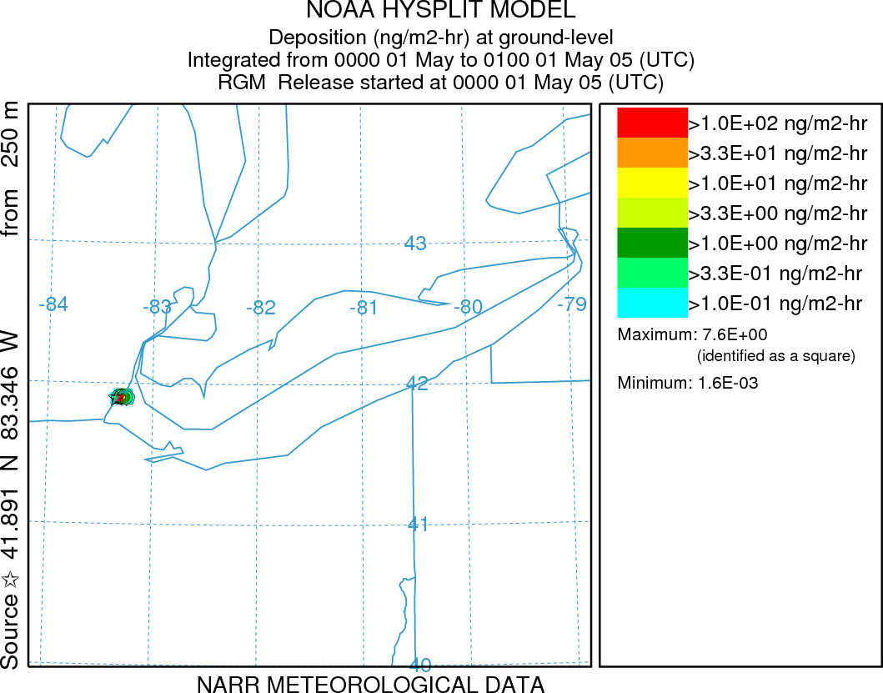
Approaches
Trajectory-based analyses with the HYSPLIT model (Winston Luke talk and Xinrong Ren poster)
Lake Erie
Beltsville
Comprehensive atmospheric fate and transport modeling with the HYSPLIT-Hg model
Lake Erie

Slide 6
Approaches (continued)
Evaluate modeling by comparison against ambient measurements
Ongoing efforts to improve accuracy of simulations, e.g., as new information becomes available

Slide 7
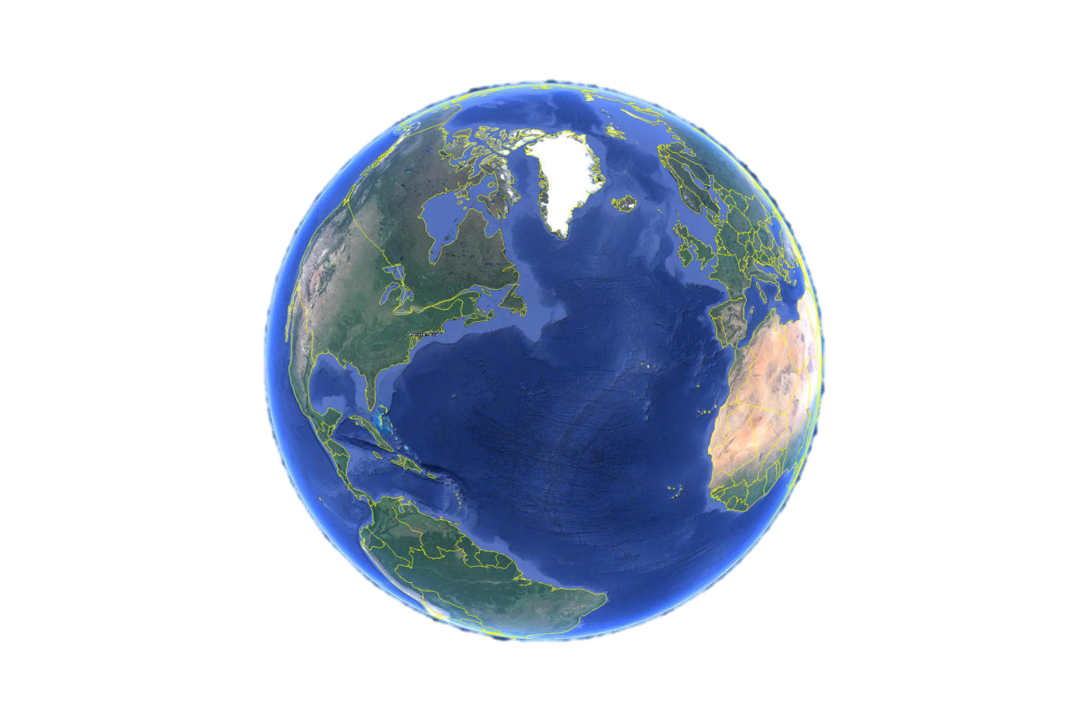
different forms of mercury in the atmosphere
Elemental Mercury: Hg(0)
most of total Hg in atmosphere
doesn’t easily dry or wet deposit
atmospheric half-life: ~6-12 months
relatively small local deposition
but, global distribution and impacts
Notes:
From an analysis carried out for: Cohen, M., R. Artz, R. Draxler. NOAA Report to Congress: Mercury Contamination in the Great Lakes. Air Resources Laboratory, Silver Spring MD. Submitted to Congress on May 14, 2007. 162 pages. Available at: http://www.arl.noaa.gov/documents/reports/NOAA_GL_Hg.pdf
Source at Latitude = 42.5, Longitude -97.5, simulation for an entire year (1996) using archived NGM meteorological data.

Slide 8
Cumulative Fraction of Emissions Deposited
as a Function of Distance from the Source
Elemental Mercury: Hg(0)
most of total Hg in atmosphere
doesn’t easily dry or wet deposit
atmospheric half-life: ~6-12 months
relatively small local deposition
but, global distribution and impacts
Hg(0)
Notes:
From an analysis carried out for: Cohen, M., R. Artz, R. Draxler. NOAA Report to Congress: Mercury Contamination in the Great Lakes. Air Resources Laboratory, Silver Spring MD. Submitted to Congress on May 14, 2007. 162 pages. Available at: http://www.arl.noaa.gov/documents/reports/NOAA_GL_Hg.pdf
Source at Latitude = 42.5, Longitude -97.5, simulation for an entire year (1996) using archived NGM meteorological data.

Slide 9
Cumulative Fraction of Emissions Deposited
as a Function of Distance from the Source
Particulate Mercury: Hg(p)
a few % of total atmos. Hg
Hg in/on atmos. particles
atmospheric half-life: ~weeks
bioavailabilty?
moderate local deposition
Hg(p)
Elemental Mercury: Hg(0)
most of total Hg in atmosphere
doesn’t easily dry or wet deposit
atmospheric half-life: ~6-12 months
relatively small local deposition
but, global distribution and impacts
Hg(0)
Notes:
From an analysis carried out for: Cohen, M., R. Artz, R. Draxler. NOAA Report to Congress: Mercury Contamination in the Great Lakes. Air Resources Laboratory, Silver Spring MD. Submitted to Congress on May 14, 2007. 162 pages. Available at: http://www.arl.noaa.gov/documents/reports/NOAA_GL_Hg.pdf
Source at Latitude = 42.5, Longitude -97.5, simulation for an entire year (1996) using archived NGM meteorological data.

Slide 10
Cumulative Fraction of Emissions Deposited
as a Function of Distance from the Source
Gaseous Oxidized Mercury: GOM
a few % of total atmos. Hg
species? (HgCl2, others)
very water soluble and sticky
atmospheric half-life: ~days
relatively large local deposition
very bioavailable after deposition
GOM
Particulate Mercury: Hg(p)
a few % of total atmos. Hg
Hg in/on atmos. particles
atmospheric half-life: ~weeks
bioavailabilty?
moderate local deposition
Hg(p)
Elemental Mercury: Hg(0)
most of total Hg in atmosphere
doesn’t easily dry or wet deposit
atmospheric half-life: ~6-12 months
relatively small local deposition
but, global distribution and impacts
Hg(0)
Notes:
From an analysis carried out for: Cohen, M., R. Artz, R. Draxler. NOAA Report to Congress: Mercury Contamination in the Great Lakes. Air Resources Laboratory, Silver Spring MD. Submitted to Congress on May 14, 2007. 162 pages. Available at: http://www.arl.noaa.gov/documents/reports/NOAA_GL_Hg.pdf
Source at Latitude = 42.5, Longitude -97.5, simulation for an entire year (1996) using archived NGM meteorological data.

Slide 11
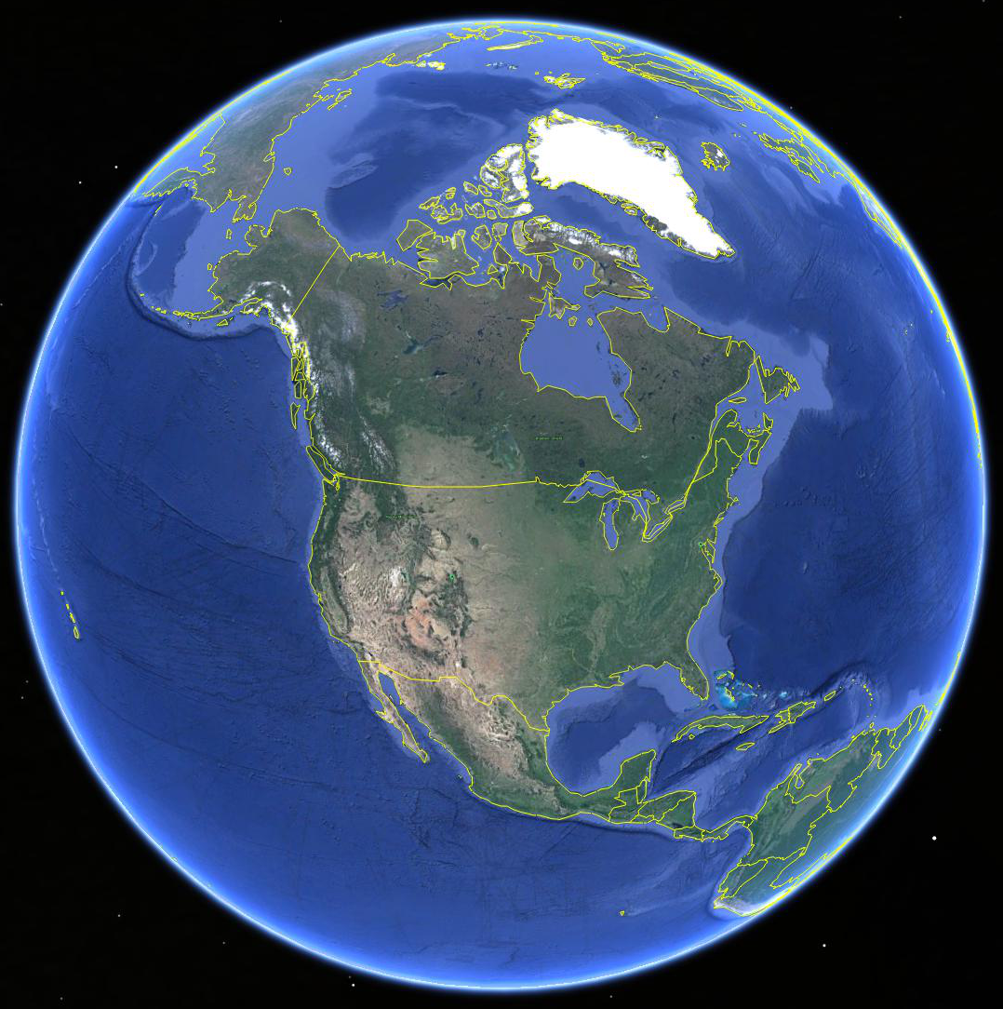


Modeling Challenge: Source Impacts on Local to Global Scales
mercury
from global atmospheric pool
entering
North
America
mercury
that doesn’t deposit continues
its global circulation
local, regional
and global sources contribute to atmospheric mercury deposition
North
American
mercury
sources
*
fish-advisories
throughout
North America
due to mercury contamination

Slide 12
Accomplishments
Trajectories
  Numerous analyses carried out at ARL
  Have shared models / scripts / methods and taught many others
Fate and Transport Modeling
  Numerous improvements to the HYSPLIT-Hg model (last ~15 years)
  Modeling system, including suite of pre- and post-processing programs
  Model results reasonably consistent with atmospheric measurements
  Global source attribution for mercury deposition to the Great Lakes

Slide 13
Accomplishment:
Lagrangian (plume) and Eulerian (grid) integrated
fate & transport modeling
When puffs grow to sizes large relative to the meteorological data grid, they split, horizontally and/or vertically
In HYSPLIT-Hg, puffs can now be “dumped” into an Eulerian grid after a specified time (e.g., 96 hrs), and the mercury is simulated on that grid from then on…
Ok for regional simulations,
but for global modeling,
puff splitting
overwhelms
computational
resources
Atmospheric chemistry & deposition simulated for each puff

Slide 14
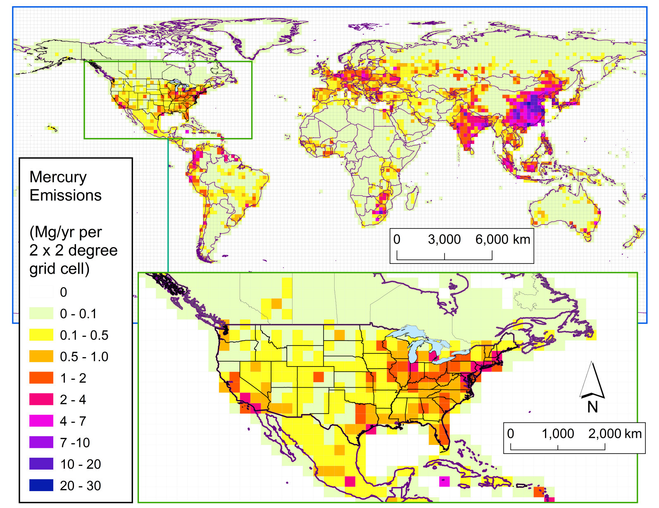
Accomplishment:
Modeling System (…starts with emissions)
These are estimated anthropogenic mercury emissions for 2005, based on the AMAP-UNEP Global Inventory
Other emissions also needed, e.g.:
biomass burning
volcanic
oceanic
soil/vegetation
+ meteorological data to drive the model (NOAA!)
Notes:
This is from AMAP/UNEP 2010 global 0.5 x 0.5 degree anthropogenic emissions inventory. It was transferred to a 2x2 global grid, so the spatial patterns could be seen more easily.

Slide 15
Accomplishment:
encouraging agreement with wet deposition measurements
But, certainly room for improvement!
Notes:
These are results for the base case model configuration, in the manuscript submitted Feb 2016 to Elementa.
Figure 8. Modeled vs. measured 2005 mercury wet deposition for the base case (1A).
Measured, annual mercury wet deposition is compared with the modeled base-case estimate, for each Mercury Deposition Network (MDN) site with essentially complete data for 2005. The sites are categorized by region as shown in Figure 6. The 1:1 line is also shown.

Slide 16
Accomplishment:
encouraging agreement with atmospheric concentration measurements
Again, certainly room for improvement
But also, measurements of GOM and Hg(p) may be somewhat biased low

Slide 17
Accomplishment:
encouraging agreement, although challenging for many reasons, e.g., different forms of mercury are present at concentrations differing by orders of magnitude

Slide 18
Accomplishment:
Model Estimated Source Attribution for
2005 Great Lakes Atmospheric Mercury Deposition
Notes:
These are the results for the Base Case, in the Elementa manuscript (submitted Feb 2016)

Slide 19
Quality
Publications
Reimbursable Support
Recognition

Slide 20
Quality: Publications
Peer Reviewed (in process)
Cohen, M., et al. (2016). Modeling the global atmospheric transport and deposition of mercury to the Great Lakes. Elementa, Submitted.
Ren, X., et al. (2016). Atmospheric Mercury Measurements at a Suburban Site in the Mid-Atlantic United States: Inter-annual, Seasonal and Diurnal Variations and Source-Receptor Correlation. Atmospheric Environment, Submitted.
Zhou, C., et al. (2016). Mercury temporal trends in top predator fish of the Laurentian Great Lakes from 2004 to 2014: are global mercury inputs affecting the Great Lakes ecosystem? ES&T, in prep.
Peer Reviewed (published)
Anderson, D., et al. (2015). New Interpretation of Tropical High Ozone/Low Water Structures: Pervasive Role of Biomass Burning. Nature Communications, 7:10267.
Stein, A., et al. (2015). NOAA’s HYSPLIT Atmospheric Transport and Dispersion Modeling System. Bulletin of the American Meteorological Society, 96, 2059-2077.
Ngan, F., et al. (2015). Meteorological modeling using the WRF-ARW model for Grand Bay intensive studies of atmospheric mercury. Atmosphere 6, 209-233.
Brooks, S., et al. (2014). Airborne Vertical Profiling of Mercury Speciation near Tullahoma, TN, USA. Atmosphere 5, 557-574.
Lei, H., et al. (2014). Projections of atmospheric mercury levels and their effect on air quality in the United States, Atmos. Chem. Phys. 14, 783-795.
Ren, X., et al. (2014). Mercury Speciation at a Coastal Site in the Northern Gulf of Mexico: Results from the Grand Bay Intensive Studies in Summer 2010 and Spring 2011. Atmosphere 5, 230-51.
Denkenberger, J.S., et al. (2012). A Synthesis of Rates and Controls on Elemental Mercury Evasion in the Great Lakes Basin. Environmental Pollution 161, 291-298.
Schmeltz, D., et al. (2011). MercNet: a National Monitoring Network to Assess Responses to Changing Mercury Emissions in the United States. Ecotoxicology 20: 1713-1725.
Technical Reports
Cohen, M. (2016). Modeling Atmospheric Mercury Deposition to the Great Lakes: Updated Analysis. GLRI FY13 Final Report.
Evans, D. W., et al. (2015). White Paper on Gulf of Mexico Mercury Fate and Transport: Applying Scientific Research to Reduce the Risk from Mercury in Gulf of Mexico Seafood. NOAA Technical Memorandum, NOS NCCOS #192.
Cohen, M., et al. (2014). Modeling Atmospheric Mercury Deposition to the Great Lakes: Projected Consequences of Alternative Future Emissions Scenarios. GLRI FY12 Final Report.
Cohen, M., et al. (2013). Modeling Atmospheric Mercury Deposition to the Great Lakes: Examination of the Influence of Variations in Model Inputs, Parameters, and Algorithms on Model Results. GLRI FY11 Final Report.
Cohen, M. (2012). Notes on Mercury Emissions and Atmospheric Deposition within the Lake Superior Basin. A report requested by the binational Lake Superior Work Group.
Cohen, M., et al. (2011). Modeling Atmospheric Mercury Deposition to the Great Lakes. GLRI FY10 Final Report.

Slide 21
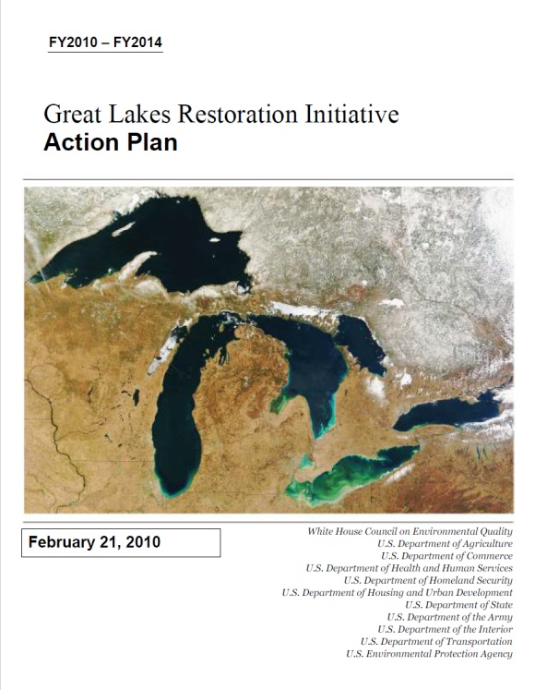

Quality: Reimbursible Support
FY10 Great Lakes Restoration Initiative
FY11 Great Lakes Restoration Initiative
FY12 Great Lakes Restoration Initiative
FY13 Great Lakes Restoration Initiative
FY14 Great Lakes Restoration Initiative
FY15 Great Lakes Restoration Initiative
Cumulative Reimbursable Funding, FY10-FY15: $830K
Notes:
Note – GLRI funding is provided through an IAG that is developed between NOAA and EPA. Due to the time required to develop each year’s IAG, the funds for any given FY’s award actually come to NOAA sometime in the middle to the end of the FY. So, for example, the FY10 funds arrived at NOAA in April 2010, and the award covered work that was carried out between then and Dec 2011

Slide 22

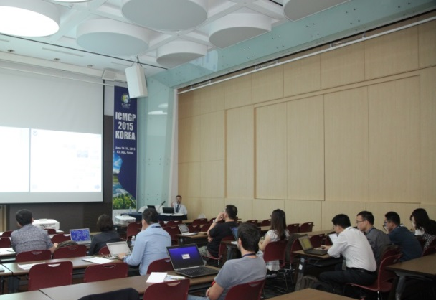

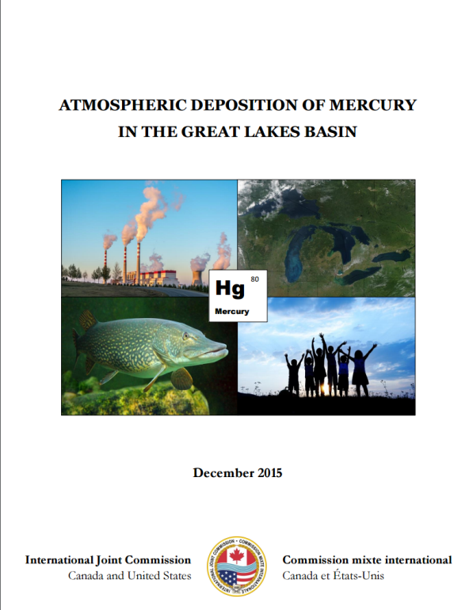
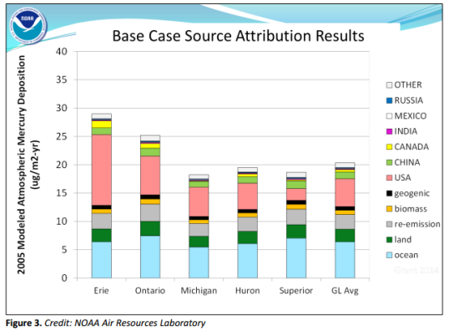
Quality: Recognition
Invited to develop/teach hands-on course on analysis of atmospheric mercury data using back-trajectory modeling, at the 2015 International Conference on Mercury as a Global Pollutant
Invited to give presentations regarding atmospheric mercury, e.g.:
  US Department of Justice
  Air Quality Research Subcommittee (OSTP)
  International Joint Commission
  Gulf of Mexico Alliance
ARL modeling prominently featured in recent report from the International Joint Commission (IJC) concerning mercury pollution in the Great Lakes

Slide 23
Relevance
National and International Drivers
Strategic Plans
Policy-Relevant Science

Slide 24
Relevance: National and International Drivers
Clean Air Act (1990): Section 112(m) requires EPA & NOAA to study the deposition rates & sources of hazardous pollutants to the Great Lakes and coast waters.
Great Lakes Water Quality Agreement (2012): Annex 3-C requires U.S. and Canada to assess sources, transport, loading, and impact of mercury and other Chemicals of Mutual Concern to the Waters of the Great Lakes.
International Joint Commission (2015): U.S. & Canada should increase and provide sustainable funding to measure Great Lakes atmospheric mercury deposition and carry out modeling to assess source attribution for this deposition.
Minimata Convention (UNEP, 2013): Article 19 calls on the Parties to model the levels of mercury in the environment and to develop information on the atmospheric transport and deposition of mercury (U.S. has signed this global treaty).

Slide 25



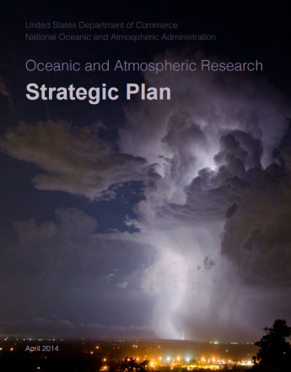

Relevance: Strategic Plans
Department of Commerce Strategic Plan
NOAA Research & Development Plan
NOAA Next Generation Strategic Plan
Oceanic & Atmospheric Research (OAR) Strategic Plan
ARL Strategic Plan
Among many other things, all plans have important goals related to:
Understanding pollution impacts on ecosystems
Improving modeling capabilities
Providing environmental information for decision-making
Improving health of people, fish, and ecosystems
ARL’s atmospheric mercury modeling work supports all of these goals
Notes:
Department of Commerce Strategic Plan (2014-2018): (http://www.arl.noaa.gov/documents/doc_fy2014-2018_strategic_plan.pdf)
Ensure communities and businesses have the necessary information, products, and services to prepare for and prosper in a changing environment:
Advance the understanding and prediction of changes in the environment through world class science and observations (NIST, NOAA)
Foster healthy and sustainable marine resources, habitats, and ecosystems through improved management and partnerships (NOAA)
Enable U.S. businesses to adapt and prosper by developing environmental and climate-informed solutions (ESA, ITA, NIST, NOAA)
NOAA Five Year R&D Plan (2013-2017): (http://www.arl.noaa.gov/documents/NOAA%205%20Year%20RDPlan_2013-2017.pdf)
Healthy Oceans:
How do environmental changes affect marine and coastal ecosystems?
Resilient Coastal Communities and Economies:
How do we ensure that growing maritime commerce stays safe & sustainable?
How do we reduce the economic, ecological, & health impacts of degraded water quality?
Environmental Modeling:
How can modeling be best integrated and improved with respect to skill, efficiency, and adaptability?
NOAA Next Generation Strategic Plan (2010): (http://www.arl.noaa.gov/documents/NOAA_NGSP.pdf)
Weather-Ready Nation:
Healthy people and communities due to improved air and water quality services
A more productive & efficient economy through environ. info. relevant to key sectors of the U.S. economy
Healthy Oceans:
Improved understanding of ecosystems to inform resource management decisions
Sustainable fisheries and safe seafood for healthy populations and vibrant communities
Recovered and healthy marine and coastal species
Healthy habitats that sustain resilient and thriving marine resources and communities
Resilient Coastal Communities and Economies
Coastal and Great Lakes communities are environmentally and economically sustainable
Comprehensive ocean and coastal planning and management
Improved coastal water quality supporting human health and coastal ecosystem services
NOAA’s Science and Technology Enterprise:
A holistic understanding of the Earth system through research
An integrated environmental modeling system
NOAA’s Engagement Enterprise:
An engaged and educated public with an improved capacity to make scientifically informed environmental decisions
Integrated services meeting the evolving demands of regional stakeholders
OAR Strategic Plan: (http://www.arl.noaa.gov/documents/OARStrategicPlan.pdf)
Weather-Ready Nation: How are atmospheric chemistry and composition related to each other and ecosystems…?
Healthy Oceans: How do environmental changes affect marine and coastal ecosystems?
ARL Strategic Plan (2015-2019: (http://www.arl.noaa.gov/documents/ARL_FinalStrategicPlan_2015-2020.pdf)
Advance scientific understanding and predictive modeling capabilities of the emission, transport, chemical transformation, and air-surface exchange (including deposition and bi-directional processes) of air pollutants that impact human and ecosystem health.
Mercury Monitoring and Studies to address significant uncertainties in the amount of atmospheric mercury deposition to sensitive ecosystems and the sources of that mercury, ARL will pursue several complementary activities, including:
• Mercury modeling: Building on measurements and insights from field work by ARL and others, ARL will improve its mercury model and apply it to produce robust, policy-relevant information (e.g., source attribution for atmospheric deposition). Potential improvements include incorporation of new bromine chemistry, better methods of providing concentrations of key reactants (e.g., hydroxyl radical) to the model, and a more realistic simulation of surface-exchange processes. In addition, modeling efforts will be used to interpret long-term data sets collected at the surface.

Slide 26
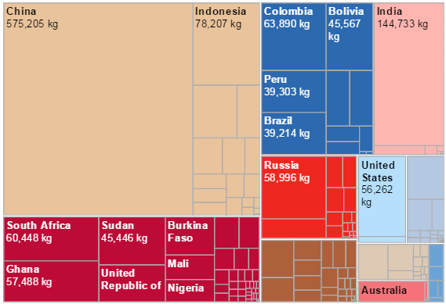
Relevance: Policy-Relevant Science
U.S. anthropogenic emissions are a small fraction of global emissions
Debate regarding the importance of local/regional atmospheric mercury emissions sources
Some have argued that local & regional sources have little impact, and if so, why regulate emissions?
Our integrated plume & grid approach is a powerful tool to examine source-receptor relationships on local to global scales
GLOBAL ANTHROPOGENIC MERCURY EMISSIONS (2010) (graphic from Kenneth Davis, USEPA, based on AMAP/UNEP 2010 mercury emissions data)
Notes:
Emissions graphic from the websites below, developed by Kenneth J. Davis, based on AMAP/UNEP 2010 global anthropogenic emissions data
https://geovisualist.com/2014/05/09/updated-global-mercury-pollution-viz-and-graphics/
http://public.tableau.com/shared/5S8FCT7QX?:display_count=no&:showVizHome=no

Slide 27
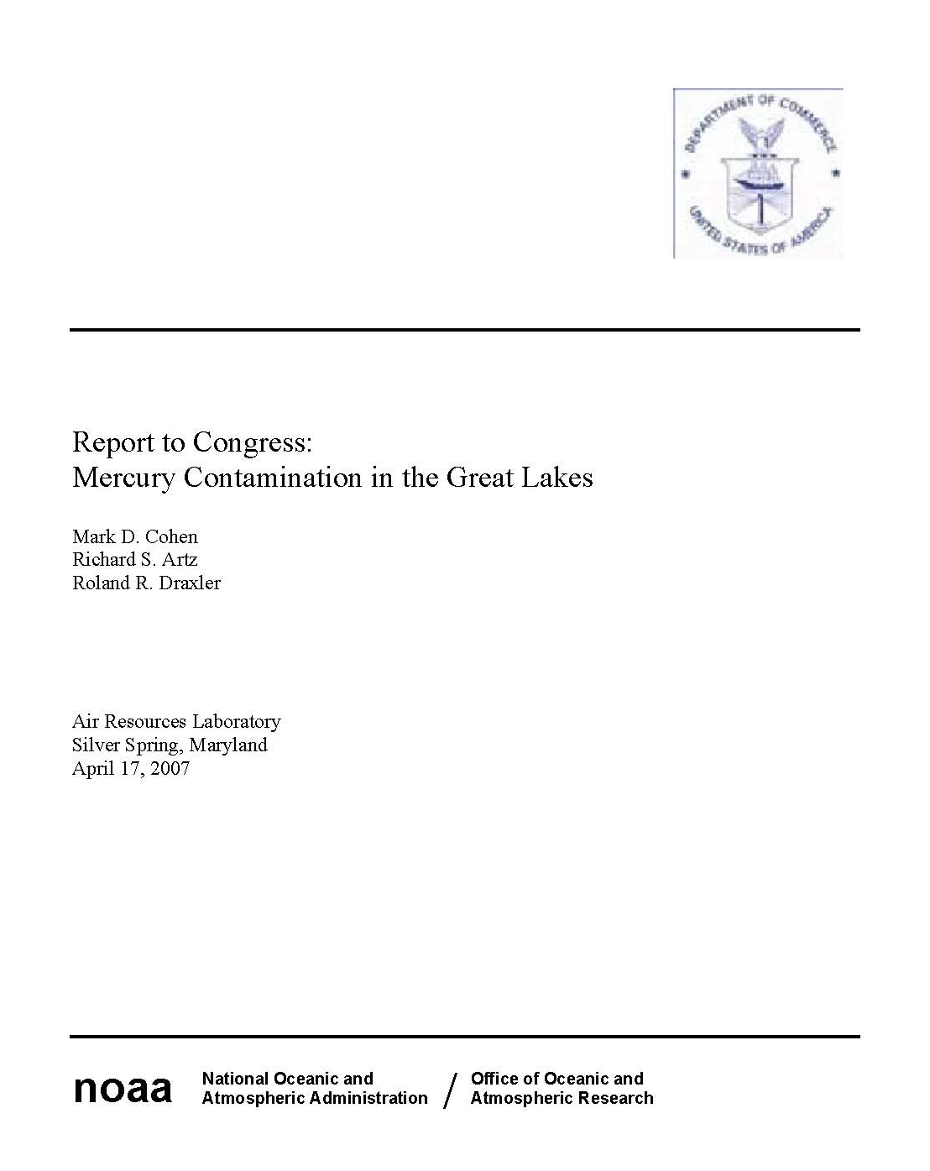
Relevance: Policy-Relevant Science
Emissions and deposition to Lake Michigan
arising from different distance ranges
(based on 1999 anthropogenic emissions in the U.S. and Canada)
2007 NOAA Report to Congress on
Mercury Contamination in the Great Lakes
… but “local” emissions responsible for a large fraction of the modeled atmospheric deposition
small % of U.S. and Canadian emissions
< 100 km
of Lake Michigan

Slide 28
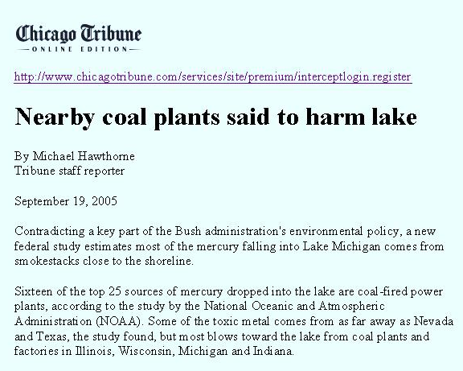
Relevance: Policy-Relevant Science
Notes:
Based on a draft of the Report to Congress, released in 2005

Slide 29
Relevance: Policy-Relevant Science
The next day, EPA drafts a letter to Chicago Tribune Editor:
Your article, "Nearby coal plants said to harm lake," reached conclusions that are not supported by the latest research and science on how mercury emissions from power plants affect Lake Michigan...
(which they hoped would be signed by NOAA and EPA)
… NOAA Management convinced EPA to drop
their effort to discredit this work …
Notes:
Thanks to Rick Rosen, the then head of OAR, and folks in Admiral Conrad Lautenbacher’s office (Lautenbacher was Administrator of NOAA at the time).

Slide 30
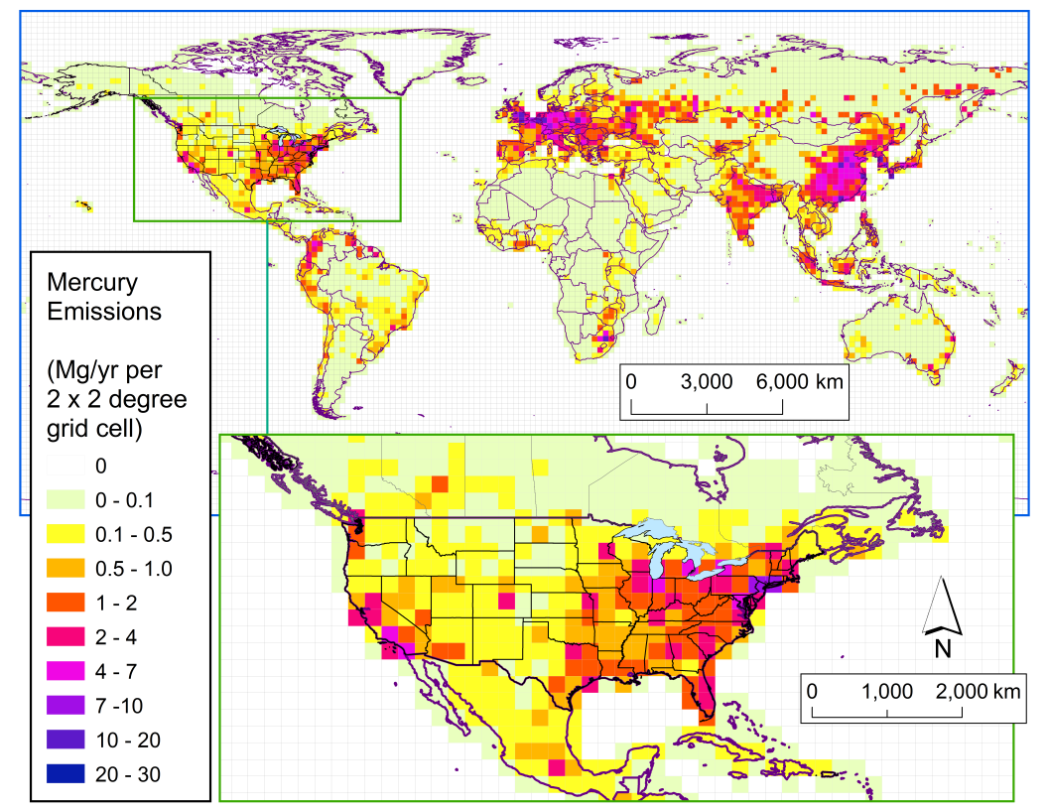
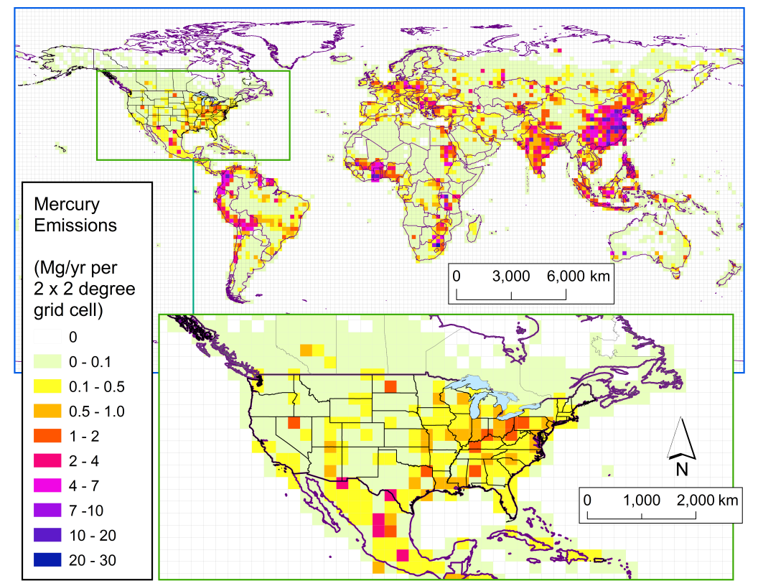
What has happened?
Anthropogenic Mercury Emissions
1990
2014
Decrease in U.S./Canadian emissions
Decrease in European emissions
Increase in emissions from small-scale gold-mining (e.g., South America, Africa)
Mixed trends in Asia (some increases, some decreases)
Notes:
Emissions data for 1990-2010 from AMAP/UNEP V6 global emissions inventory, expressed on a 2x2 degree global grid
Emissions data for 2014 adjusted for US based on 2014 TRI data
2014 emissions data for the rest of the world assumed constant between 2010-2014, as no data were available

Slide 31
What has happened?
Time trend in anthrop. mercury emissions in different distance ranges from Lake Erie
Emissions in the rest of the world have stayed the same or even increased
Emissions in North America and in the
Great Lakes region have declined dramatically
Notes:
Distance range calculated from the centroid of Lake Erie.
Emissions data for 1990-2010 from AMAP/UNEP V6 global emissions inventory, expressed on a 2x2 degree global grid
Emissions data for 2014 adjusted for US based on 2014 TRI data
2014 emissions data for the rest of the world assumed constant between 2010-2014, as no data were available

Slide 32
What has happened?
Recent trends in Great Lakes fish mercury concentrations
Zhou, C., et al. (2016). Mercury temporal trends in top predator fish of the Laurentian Great Lakes from 2004 to 2014: are global mercury inputs affecting the Great Lakes ecosystem? Environmental Science and Technology, in preparation.
Notes:
Figure 2. General trend of fish Hg in Great Lake region from 2005 to 2014. Trends for both age normalized and raw data are shown.
From manuscript in preparation:
Mercury temporal trends in top predator fish of the Laurentian Great Lakes from 2004 to 2014: are global mercury inputs affecting the Great Lakes ecosystem?
Chuanlong Zhou¹, Hao Zhou², Timothy A. Johnson², Bernard A. Crimmins¹, Philip K. Hopke¹, Thomas M. Holsen¹
¹ Department of Civil and Environmental Engineering, Clarkson University, Potsdam, NY 13676.
² Institute for a Sustainable Environment, Clarkson University, Potsdam, NY 13676.

Slide 33
Emerging consensus: local/regional mercury sources do matter…
(in agreement with ARL’s mercury modeling results, first published in 2004)
Sunderland, Driscoll, et al. (2016), Benefits of regulating hazardous air pollutants from coal and oil-fired utilities in the United States, ES&T 50, 2117:
accumulating weight of evidence: local/regional mercury sources matter
power plant contributions to locally deposited mercury underestimated by EPA
Giang and Selin (2016), Benefits of mercury controls for the United States, PNAS 113, 286:
socioeconomic and environmental modeling analysis
benefits about an order of magnitude higher for U.S. domestic action, as compared to global action, per pound of prevented emissions (for consumers eating domestic fish)
Xinrong Ren, Winston Luke, et al. (2016), Atmospheric mercury measurements at a suburban site in the Mid-Atlantic United States: inter-annual, seasonal, and diurnal variations and source-receptor correlation, Atmospheric Environment, in review
When air comes from regional source regions, higher Hg concentrations at Beltsville
As regional emissions have decreased, Hg concentrations at Beltsville have decreased, in spite of constant and even increasing emissions in most of the rest of the world

Slide 34
Performance
Collaborations and Leveraging
Computational Advancements

Slide 35
Performance: Collaborations
NOAA
ARL’s HYSPLIT group
ARL’s mercury measurement group
National Weather Service (NWS)
National Ocean Service (NOS)
Other Federal Agencies and Programs
EPA Clean Air Markets Division (CAMD)
National Atmospheric Deposition Program
Great Lakes Restoration Initiative (GLRI)
United States Geological Survey (USGS)
Universities and Institutes
Clarkson University
Desert Research Institute
Ecosystem Research Institute
University of Washington
Utah State University
Florida State University
Jackson State University
Rutgers University
Syracuse University
Texas Christian University
University of Maryland
University of Michigan
State/Local/Tribal
State of Maryland TMDL
Red Cliff Band of Lake Superior Chippewa
Clark County, Nevada
Gulf of Mexico Alliance (FL, TX, MS, AL, LA)
International Agencies and Organizations
Environment Canada
Arctic Monitoring & Assessment Program (AMAP)
Norwegian Institute for Air Research (NILU)
International Joint Commission (IJC)
Commission for Environmental Cooperation (CEC)

Slide 36
Performance: Collaborations and Leveraging
( )
NOAA
ARL’s HYSPLIT group
ARL’s mercury measurement group
National Weather Service (NWS)
National Ocean Service (NOS)
Other Federal Agencies and Programs
EPA Clean Air Markets Division (CAMD)
National Atmospheric Deposition Program
Great Lakes Restoration Initiative (GLRI)
United States Geological Survey (USGS)
Universities and Institutes
Clarkson University
Desert Research Institute
Ecosystem Research Institute
University of Washington
Utah State University
Florida State University
Jackson State University
Rutgers University
Syracuse University
Texas Christian University
University of Maryland
University of Michigan
State/Local/Tribal
State of Maryland TMDL
Red Cliff Band of Lake Superior Chippewa
Clark County, Nevada
Gulf of Mexico Alliance (FL, TX, MS, AL, LA)
International Agencies and Organizations
Environment Canada
Arctic Monitoring & Assessment Program (AMAP)
Norwegian Institute for Air Research (NILU)
International Joint Commission (IJC)
Commission for Environmental Cooperation (CEC)
Notes:
Extensive leveraging occurs with this program and the groups, institutions, agencies highlighted in orange.
ARL’s HYSPLIT group: model R&D carried out for HYSPLIT is transferred whenever appropriate to HYSPLIT-Hg (and vice versa); archived met data used
ARL’s mercury measurement group: measurements are used for model evaluation; models are used to help interpret measurements
NOAA National Weather Service: meteorological model output used to drive HYSPLIT-Hg
Clarkson University: measurement data used for model evaluation; modeling used to help interpret trends in fish concentrations
Univ of Wash, Utah State Univ, Desert Research Inst, Ecosystem Research Inst: measurement data used for model evaluation
EPA Clean Air Markets Division: emissions data used for model input, etc.; measurement data used for model input and evaluation, etc.
NADP: Mercury Deposition Network (MDN) and Atmospheric Mercury Network (AMNet) data used for model evaluation; modeling used to help interpret measurements
Environment Canada: emissions data used for model input; measurement data used for model evaluation
Arctic Monitoring and Assessment Program and the Norwegian Inst for Air Research: emissions data used for model input

Slide 37
Performance: Computational Advancements
New computational server
  “mercury2” added in late fall, 2014
  96 virtual processors, 6 times more powerful than the 16-processor machine in use since 2009
  Now: 112 virtual processors for mercury modeling
Parallelization of HYSPLIT-Hg
  Parallelization of Lagrangian and Eulerian components has just been accomplished (Dr. Chris Loughner)
  opens the door to several new advances / capabilities, e.g.,
    Finer grids; Longer simulations; additional model complexity
    More efficient model development and testing

Slide 38

Key Challenges
Model Inputs
  Emissions inventories need to be: Timely. Accurate. Complete. Speciated.
Model Uncertainties
  e.g., atmospheric mercury chemistry (oxidation and reduction reactions)
Model evaluation
  Better understand and reduce model vs. measurement differences
  Can we really expect to reproduce nearfield plume events?
Model improvement
  Nested grid capability for Eulerian simulations
  More sophisticated simulation of bi-directional exchange between atmosphere and surface layers (e.g., adding ocean and terrestrial sublayers to the model)
  Add additional chemistry/physics (e.g., reactive bromine)
Strategic
  Enhance linkages with stated, directly related goals within NOAA & other agencies?
  Resources to do more, e.g., support modeling elements of global Minimata Treaty?

Slide 39
Future Directions
Work to address above challenges
Increasingly detailed model evaluation by comparison of results with measurements at ARL and other sites
Modeling over longer time scales to see how/if the model can reproduce trends in measurements
Examination of other receptors (e.g., Gulf of Mexico, Gulf of Maine, Chesapeake Bay, …)

Slide 40

Thanks…
Questions?
Notes:
Lake Michigan, photo from: http://lakesideviews.blogspot.com/2013/02/share-some-great-lakes-love-this.html

